Slide 1


Slide 2
A2 Chemistry
Polarity

Slide 3
Objectives
the polarity of molecules can be explained and predicted using knowledge of molecular shape, understanding of symmetry, and comparison of the electronegativity of atoms involved in the bond formation

Slide 4
Key words
electronegativity
polar bond
asymmetry
polar molecule
polarity
dipole

Slide 5
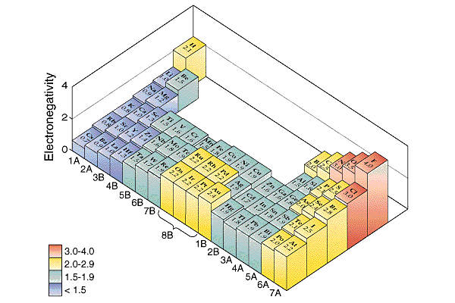
Polar bonds
Electronegativity is a measure of how strongly an atom attracts electrons
Within any covalent bond, electrons are shared between two atoms.

Slide 6

If the atoms at each end of a bond have different electronegativity, the electrons will be located, on average, closer to the more electronegative atom
This creates a polar bond, with one end slightly more negative and one end slightly more positive.

Slide 7
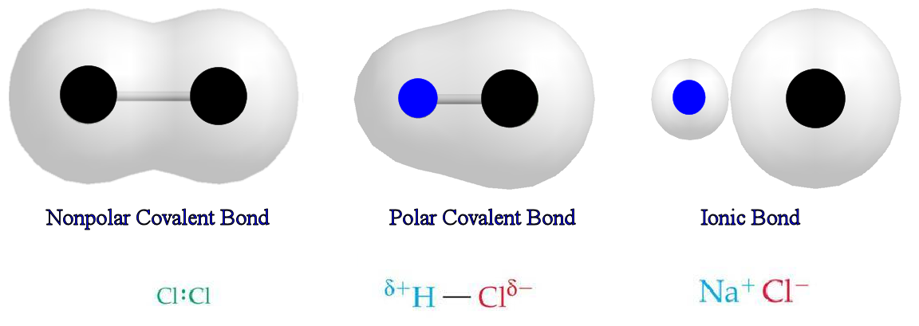

Slide 8
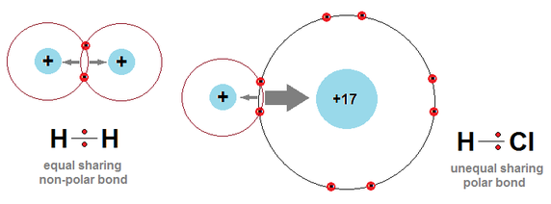
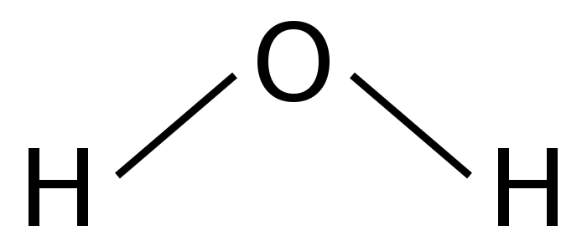

Polar molecules
Polar molecules have uneven distribution of electrons, and therefore charge.
To achieve this they must:
contain polar bonds
be asymmetrical
H = H H - Cl

Slide 9
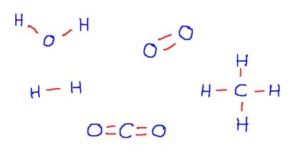

Slide 10
Polarity affects
intermolecular bonding
melting and boiling point
solubility

Slide 11
Do now

